Slide 1
MAS THEORY
The Method of Auxiliary Sources and its application to the Electromagnetic problems
Presentation by
DR. Assoc. Prof.
VASIL TABATADZE

Slide 2
2D case

Slide 3
TM FIELD
Time deppendence is
Maxwell equation has the next form
For TM field assume that
Electric field has only z component
The same for J. Then Maxwell equations lead to:
(1)
This is the two-dimensional Helmholtz equation. K is the wave number

Slide 4
Let’s consider field due to the fillament of current I:
(2)
Field point radius vector
source point radius vector
Intrinsic impedance of free space
Hankel function of the second kind and zero order
In (2) is the Green’s function of the operator (1)
A general solution is then the superposition of
Due to all elements of source

Slide 5
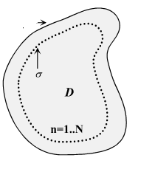
Main idea of MAS
The case of the perfectly conductor cylinder
Let’s consider cylinder perfectly conductor scatterer with surface C. Incident field excites current
on the C and we get the scattered field. In order to find the scattered field we have to determine
Currents excited on the surface. For this we have to requre boundary condition sattisfaction on
The scatterer’s surface. In case of the perfect conductor the tangential component of the total
electric field (scattered field + incident field) must be zero.
C
Considering this we get the integral equation:
In order to determine the scattered field we need to find the current distribution first

Slide 6
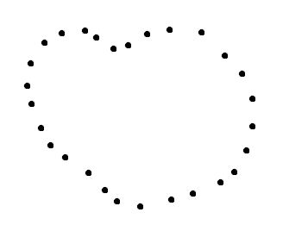
We represent the scatterer by the discrete N points
We should satisfy the boundary condition sattisfaction in each point. As a result we
get linear integral equation system.
In order to solve this system we simplify the problem and go from integral to the sum. Instead of continous distribution of current we get discretized current. And instead of linear integral equation system we get linear algebraic system. Each collocation point (where we require boundary condition sattisfaction) corresponds to discrete current point. This gives singularity because of the Hankel’s function. Other methods use regularization to avoid singularity (they add a positive number to the green function argument. Some authors requre boundary condition sattisfaction between the points). MAS uses different approach: We use scattered field fundamental property. Scattered field is analytical on the scatterer’s surface. Besides the fact that currents are excited on the scatterer surface, the E field value is finite. This is integrable singularity. This gives possibility to analitically continue field inside scatterer. and as a result shift the current surface inside the scatterer so the source points and collocation points does not coincide.

Slide 7
Scatterer’s and auxiliary surfaces
We avoid singularity. We solve this system and find the scattered field.

Slide 8
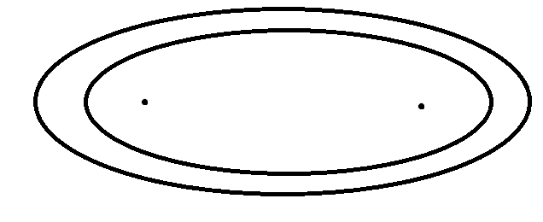
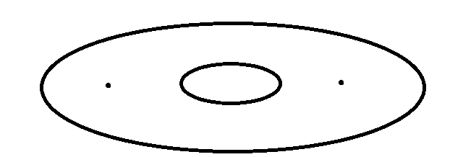
How to correctly choose the auxiliary surface
First it was thought that the auxiliary surface can be at any distance from the real surface. But practice showed that in case of elliptical scatterer when the auxiliary surface occupies ellipse focuses, the series have good convergence but when the auxiliary surface does not occupie the elipse focuses big ammount of the auxiliary sources is neaded that mens that series diverges.
converges
diverges
What is the reason of this?

Slide 9
How to correctly choose the auxiliary surface
Let’s consider simpler case
Image point of the source is the Scattered Field Singularity

Slide 10
In case of the ellipse scattered field singularities
coincides to the ellipse focuses for small ka

Slide 11
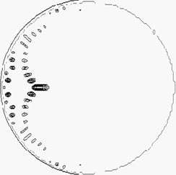
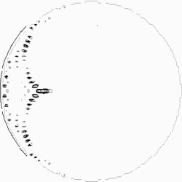
How to correctly choose the auxiliary surface
In case of the circular scatterer field singularities
coincides to the caustic surface
ka=10π
ka=20π
scattered field singularities for the ideal conductor cylinder irradiated by the plane wave
Auxiliary surface should occupie the scattered field singularity contour.
The best case is when auxiliary and scattered field singularity surfaces coinside

Slide 12
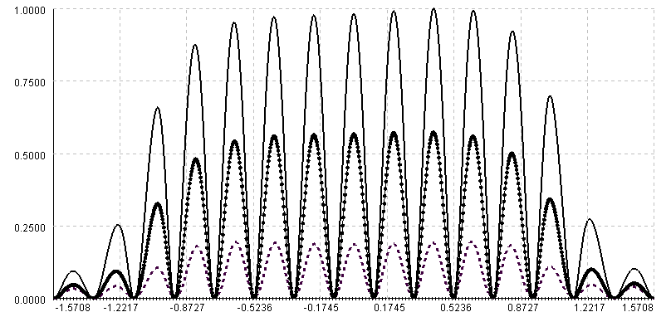
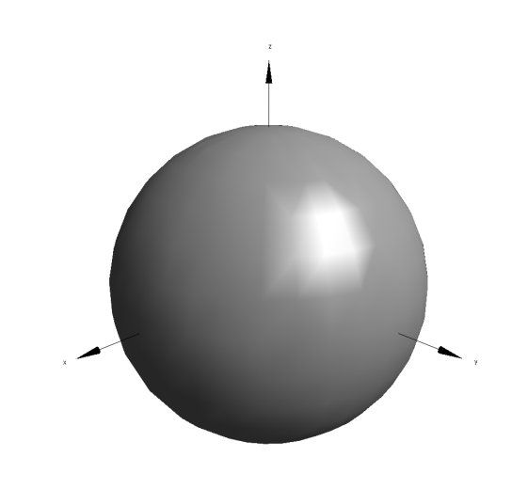
Satisfactions of boundary conditions for different removals of auxiliary sources
Distance = 0.1m
Control points
Distance = 0.12m
Distance = 0.15m
Distance = 0.4m
Radius of Sphere is 1m
Incident field is dipole. Position= ( 0, 0, 20); Polarization = (0, 1, 0) ;
AS Remove makes SF more smooth on the surface and better satisfaction of BC

Slide 13
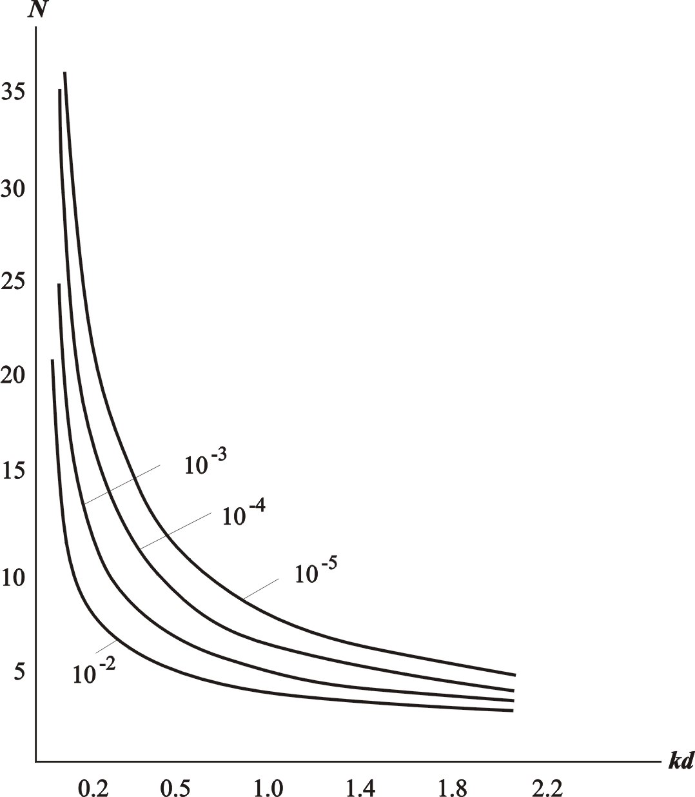
Advantage 1 of the Method of Auxiliary Sources (MAS)
Dependence of the necessary number of terms AS on the relative distance between the auxiliary and boundary surfaces for different precissions of the solution.

Slide 14
Summarize
Metal scatterer
Dielectric scatterer

Slide 15
3D case

Slide 16
Retarded Hertz Vector
Current and charge can be represented with one vector

Slide 19
A multipole expansion

Slide 20
A multipole expansion
This term corresponds to the oscilating electring dipole. The next term is:
This correspond to the magnetic dipole and the quadrupole. This term in small and we neglect it.

Slide 21
Field of the dipole
We represent the scattered field by the sum of the
electric dipole (which is called as Herth dipole) fields.
In case of the one dipole
-is a constant vector and determines the polarisation of the dipole
Electric and magnetic fields of the dipole is given by the formulae:
-Is a unit vector directed from the dipole towards the observer and

Slide 22
As in the 2D case the auxiliary surface is shifted. At each point of the auxiliary surface 2 perpendicular electric dipole are located. Boundary conditions are sattisfaied along two perpendicualar tangential vectors
-tangential vectors
second electric dipole
First electric dipole

Slide 23
Inverse problem

Slide 24
k>0
k<0
Field sof the elementary electric dipoles (k → -k ) :

Slide 25
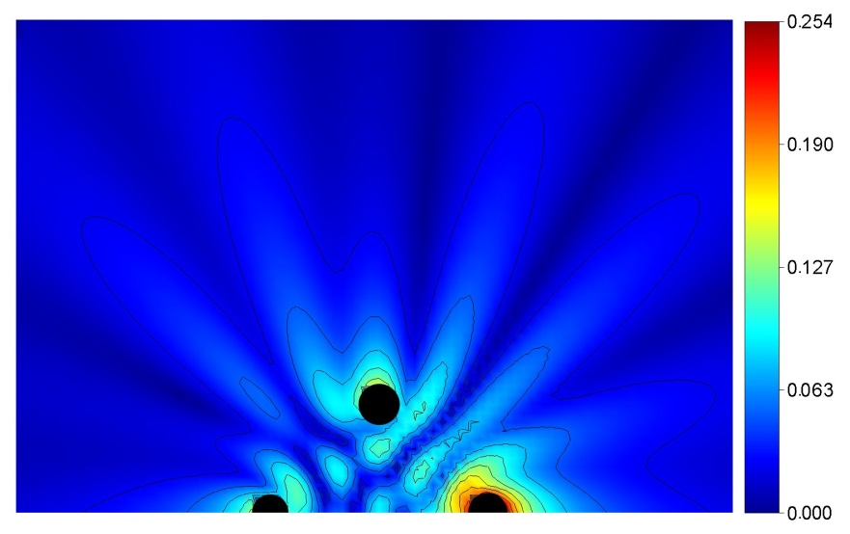
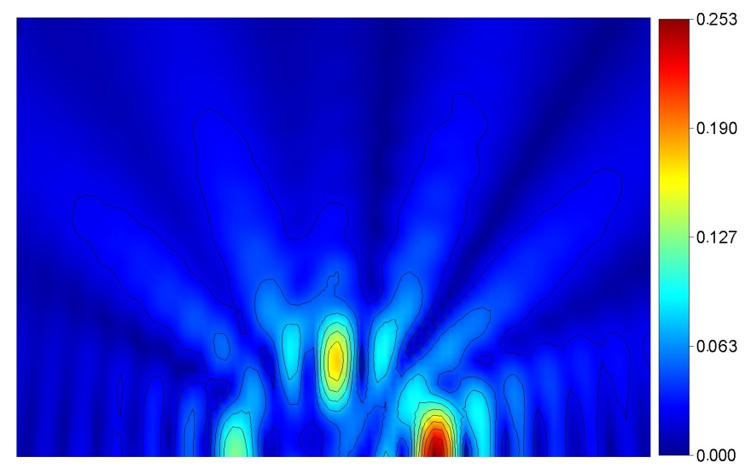
Scatterer located in vacuum
Scatterer could be considered as agregate of surces. Let’s consider 3 sources
Illuminated source
Auxiliary surface
Measured surface
Real field
Reconstructed field

Slide 26
Reconstruction of the field for two sources
Real field
Reconstructed field
K=1

Slide 27
Thank you for your attention!

